Slide 1
Cooking Up a Plan
Roger Liu
Stephen Chen
Task Planning for the Game Overcooked

Slide 2
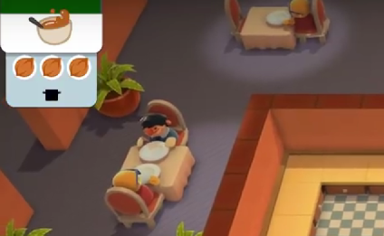
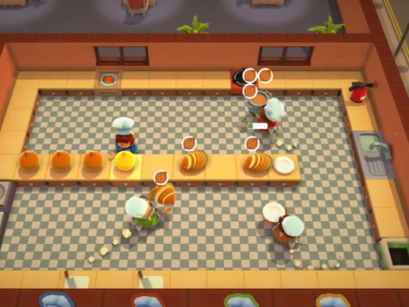
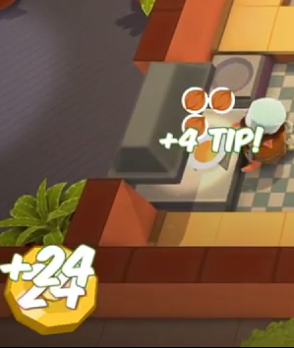
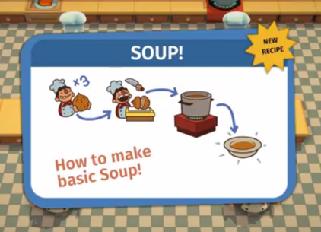
Objective
Create an AI which would learn to play an Overcooked style game
Complete Meals
Follow Recipes
Get Orders
Organize Tasks

Slide 3
Results
The length of a plan would be around 20-30 steps
Each step has on average 6 steps that can be taken
6^25 kinds of plans to search over!
Lots of local minima due to reaching an unsolvable state (ie, mixing the wrong ingredients in a soup)

